Slide 1
Scientific Machine Learning for Modeling, Optimization, and Control of Dynamical Systems
Ján Drgoňa
Associate Professor Civil and Systems Engineering Department The Ralph O'Connor Sustainable Energy Institute (ROSEI)
Data Science and AI Institute (DSAI)

Slide 2
Course Syllabus
Week 1: Introduction to Scientific Machine Learning (SciML)
Week 2: Introduction to differentiable programming
Week 3: Physics-informed neural networks (PINNs)
Week 4: Neural ordinary differential equations (NODEs)
Week 5: Neural differential equations with constraints
Week 6: Learning to optimize (L2O)
Week 7: Feasibility restoration methods in L2O
Week 8: Differentiable control
Week 9: Safety filters for learning-based control
Week 10: SciML applications
Week 11: Project evaluation with presentations

Slide 3
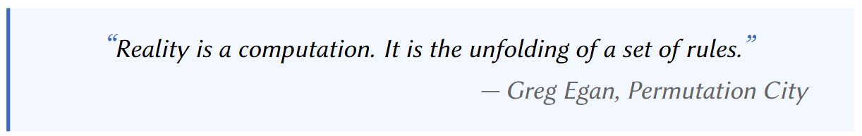
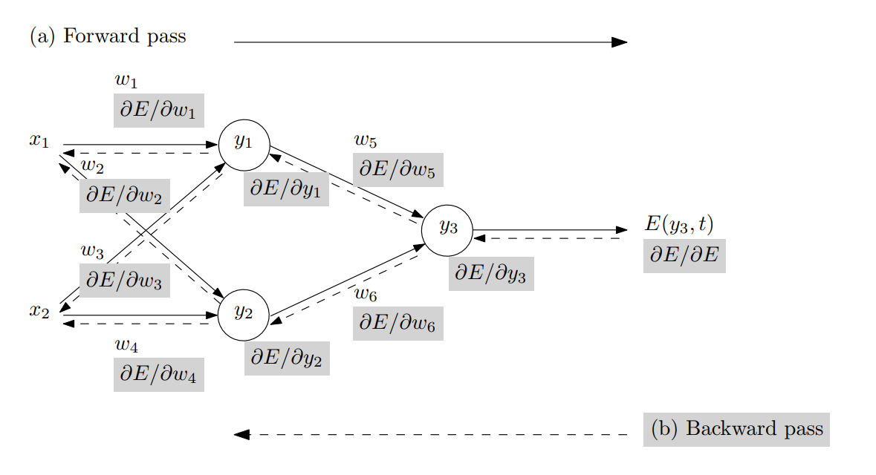
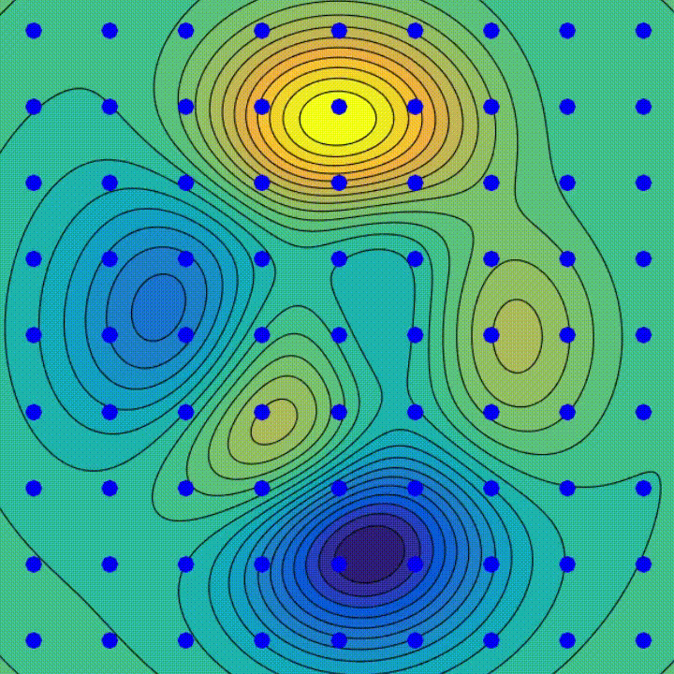
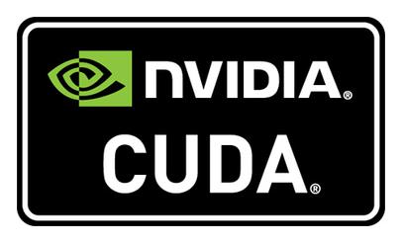

What is Differentiable Programming?
Backpropagation Algorithm
Gradient Descent Algorithm
SW and HW Innovations
Baydin, Atilim Gunes et al. Automatic differentiation in machine learning: a survey. Journal of Machine Learning Research, 2015

Slide 4
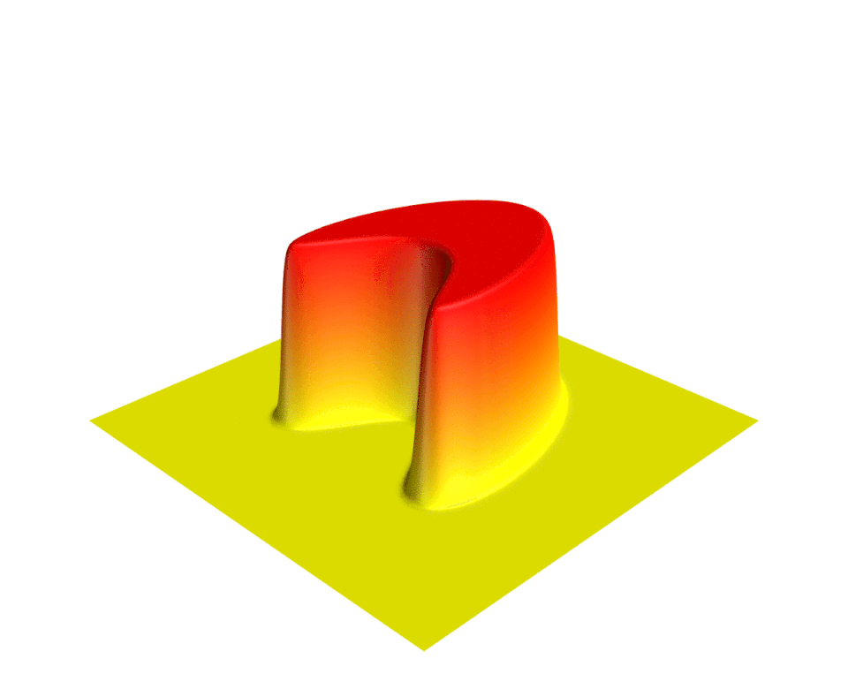
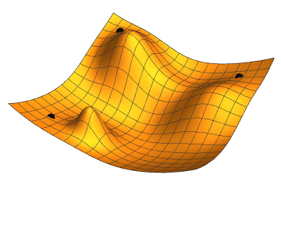
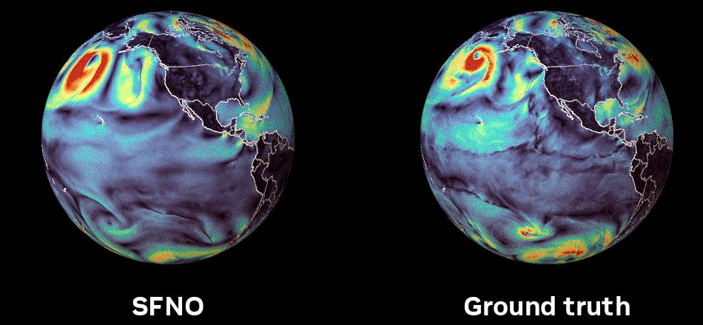
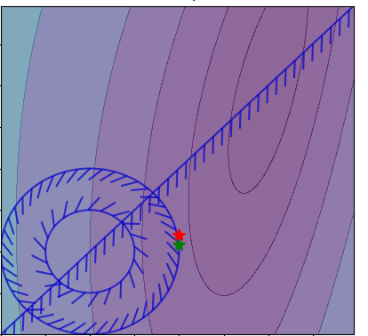
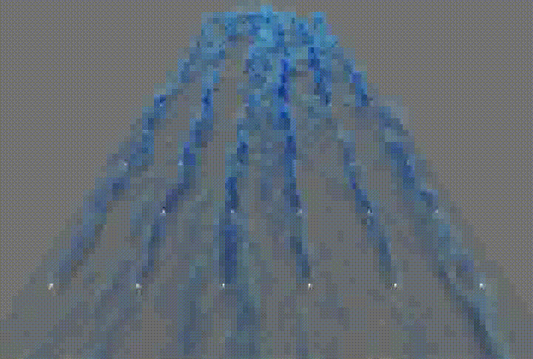
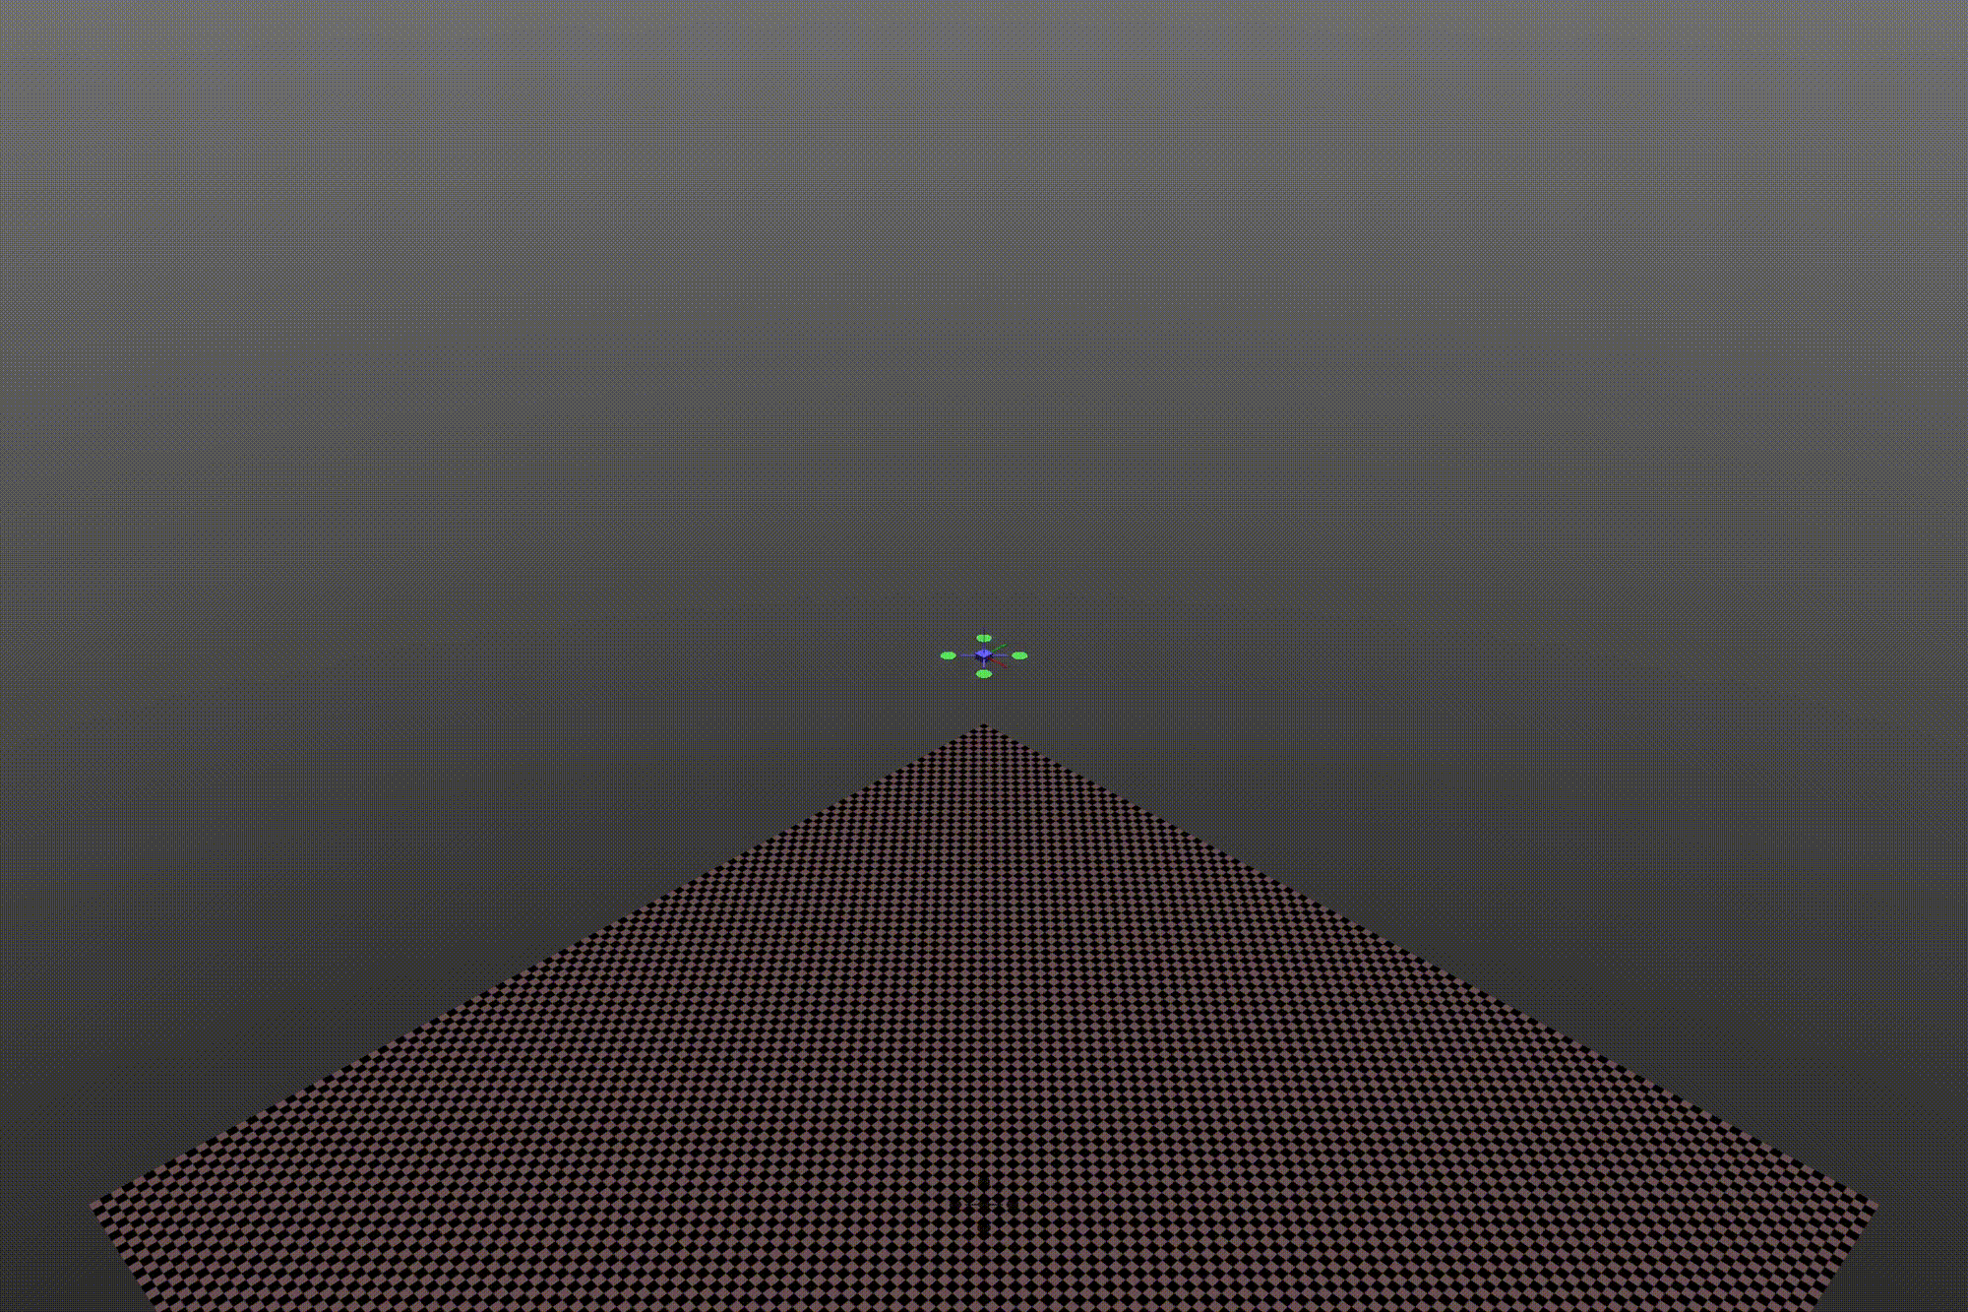
Applications of Differentiable Programming
Differential equations
Gradient-based optimization
Climate modeling
Sensitivity analysis
Sustainable energy
Robotics and control

Slide 5
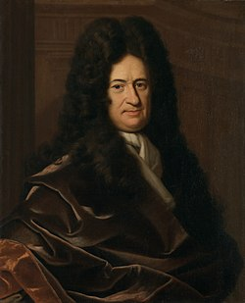
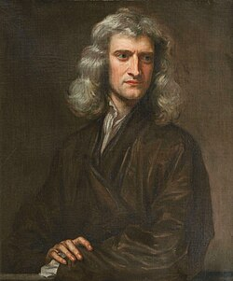


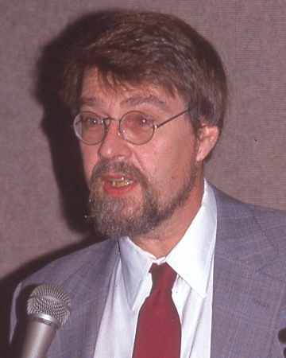
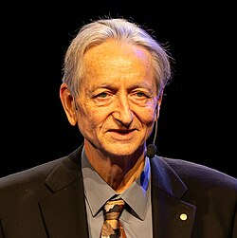

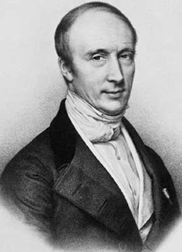
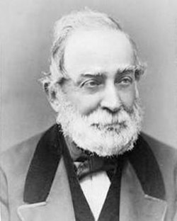
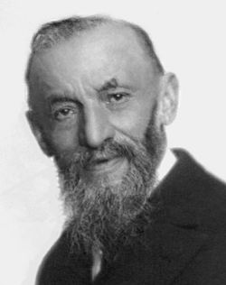




History of Differentiable Programming
20th Century: Wengert, Speelpenning, Linnainmaa, Rumelhart, Hinton, Pearlmutter
Automatic differentiation (AD) formalized and developed
17th Century: Leibniz, Newton
Foundations of calculus
19th Century: Cauchy, Genocchi, Peano
Formalized calculus and the chain rule
21st Century: Griewank, Walther, Naumann, Baydin
Comprehensive AD theory, and optimized algorithms
https://people.idsia.ch/~juergen/deep-learning-history.html https://en.wikipedia.org/wiki/Automatic_differentiation

Slide 6
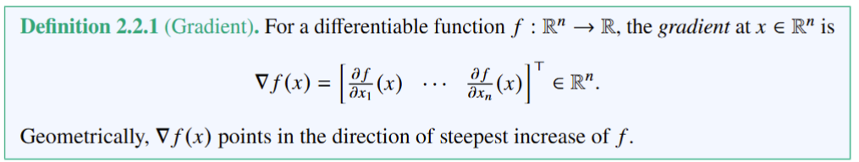
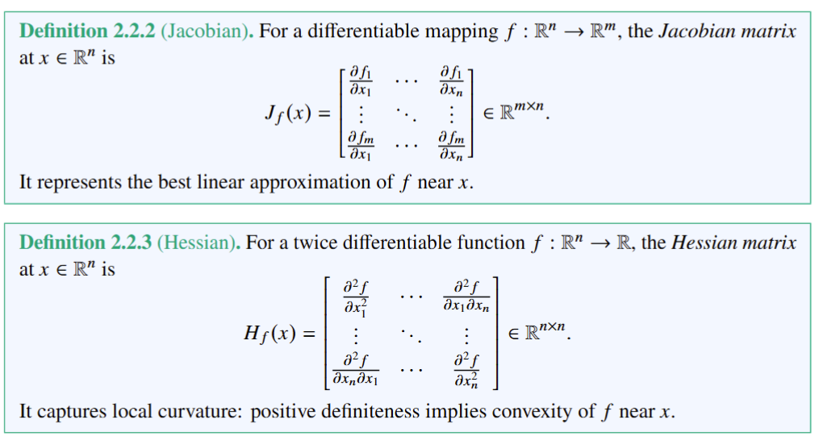
Gradients, Jacobians, and Hessians

Slide 7
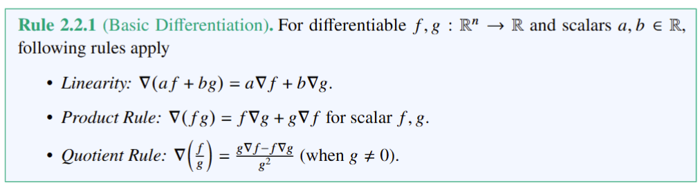
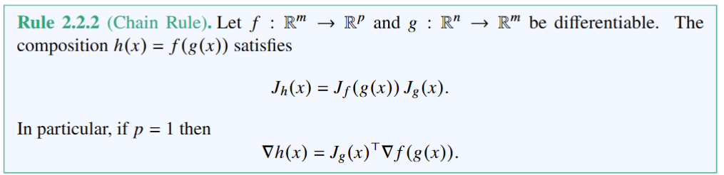
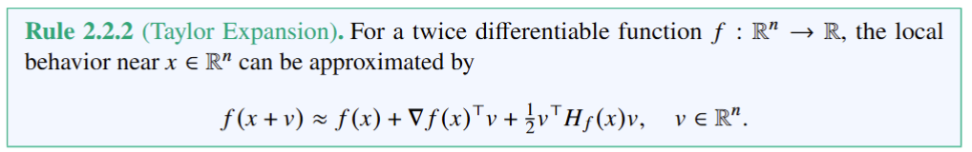
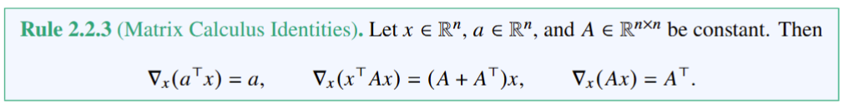
Differentiation Rules
Linearity ensures gradient operators work with sums. The product rule is essential for physics models. The quotient rule appears in normalization.
Foundation of automatic differentiation in scientific computing and backpropagation in machine learning.
Foundation of Newton’s method.
Used in optimization, control, and variational methods.

Slide 8
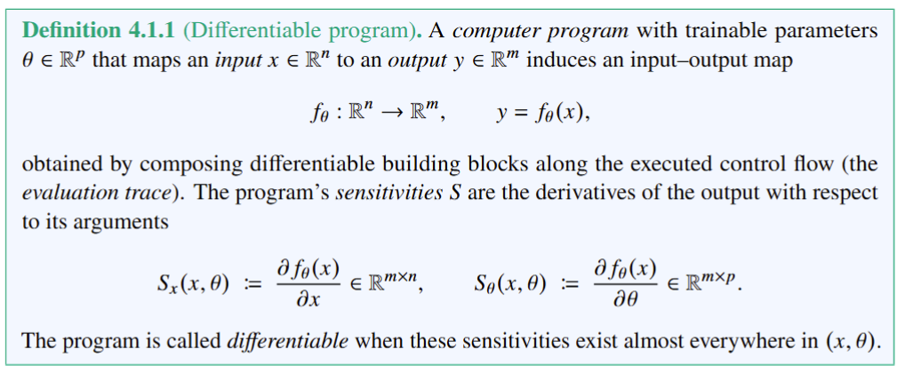
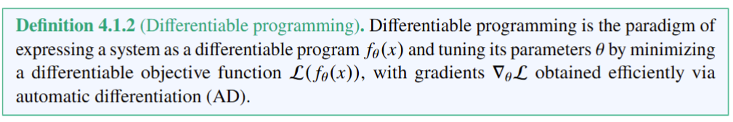
Differentiable Programming Definitions
https://en.wikipedia.org/wiki/Differentiable_programming

Slide 9
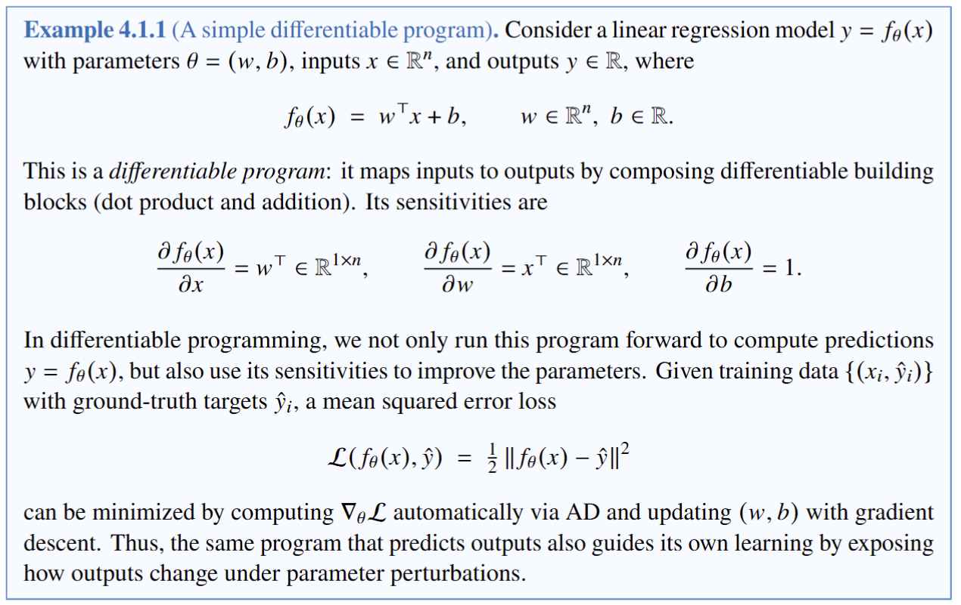
Differentiable Programming Example

Slide 10
Differentiable Programming Example

Slide 11
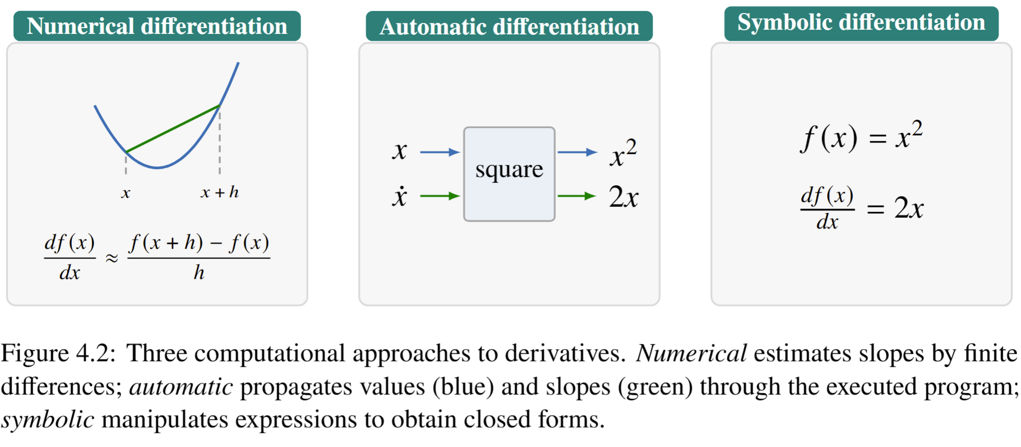
Summary of Differentiation Methods

Slide 12
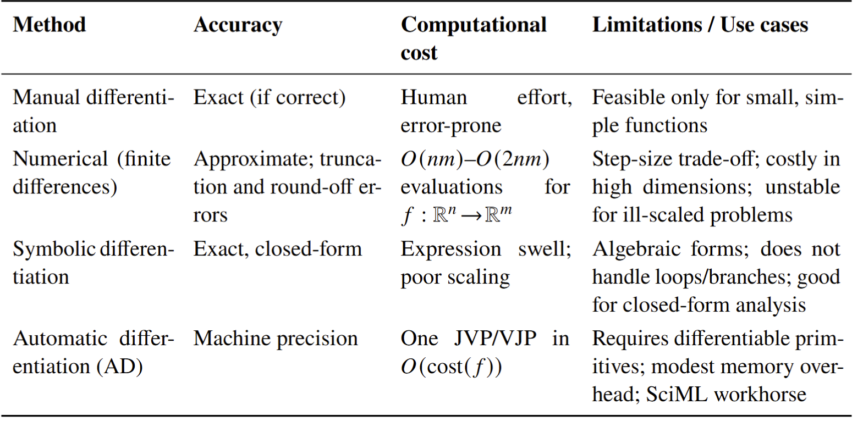
Comparison of Differentiation Methods

Slide 13
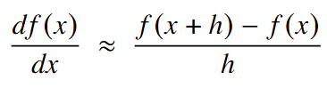
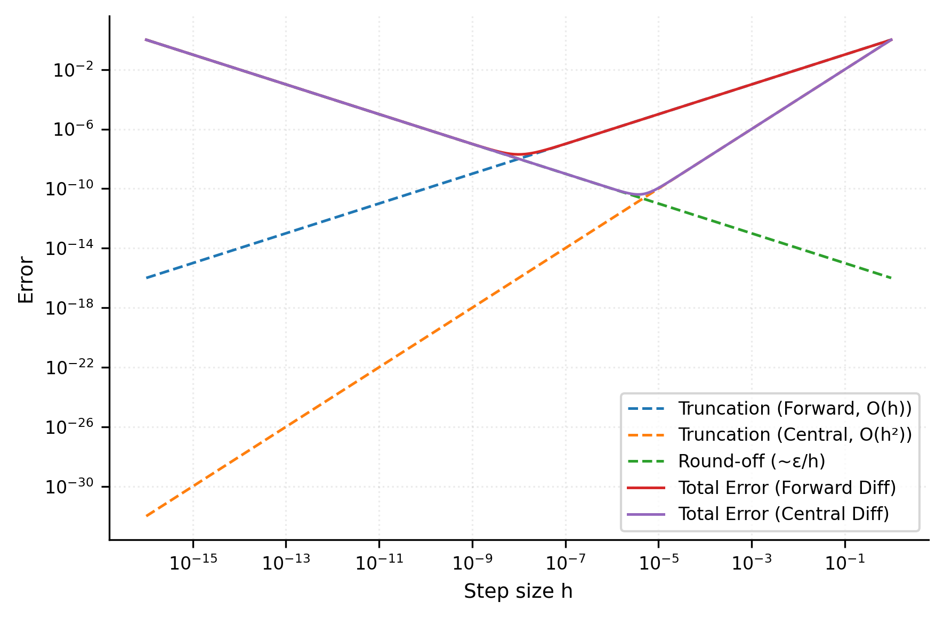
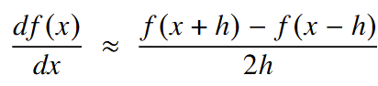
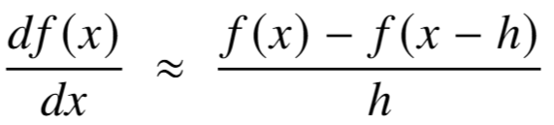
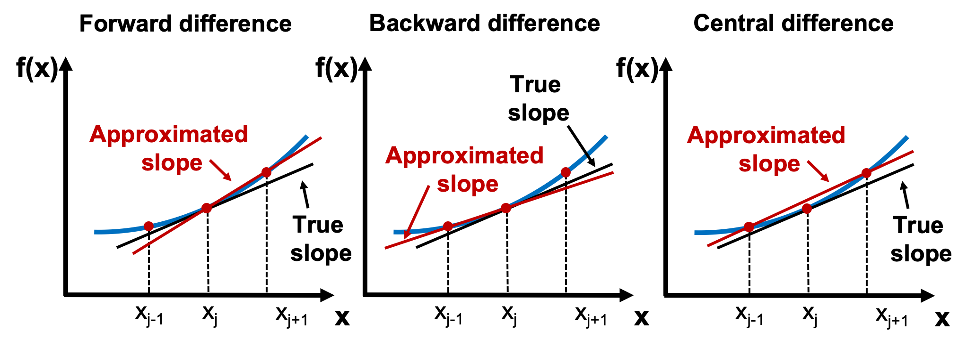
Numerical Differentiation (Finite Differences)
Approximates derivatives by evaluating the program at perturbed points. Easy to implement but yields only approximate results, is sensitive to the step size, and is expensive for large Jacobians.
Forward
Difference
Finite Difference Errors
Central
Difference
Backward
Difference
https://en.wikipedia.org/wiki/Finite_difference_method
Python Programming And Numerical Methods: A Guide For Engineers And Scientists https://pythonnumericalmethods.studentorg.berkeley.edu/

Slide 14
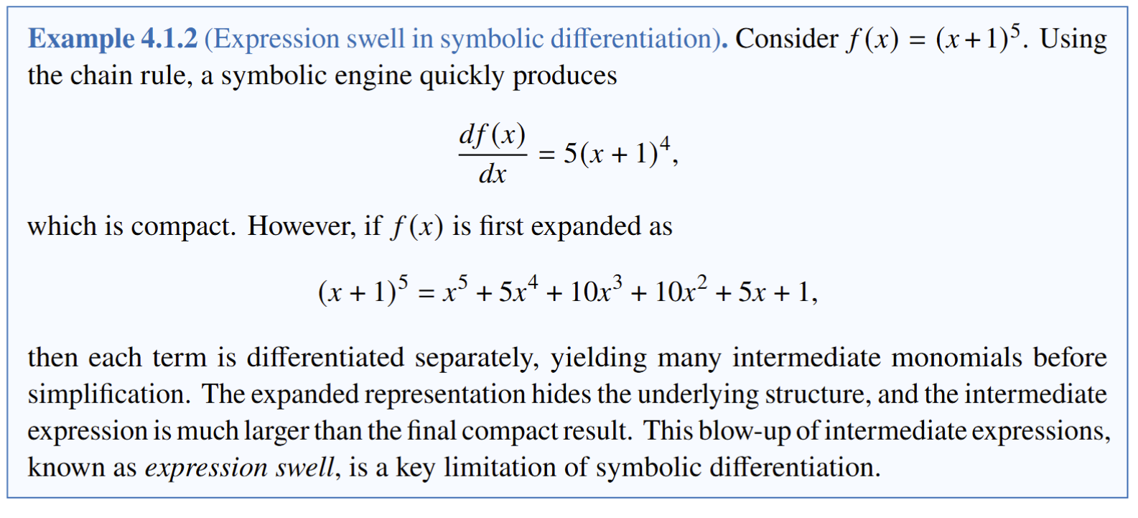
Symbolic Differentiation
Manipulates algebraic expressions according to the rules of calculus to produce exact, closed-form formulas for derivatives. It is exact but can suffer from expression swell and does not map well to general computer programs with loops and branches.

Slide 15
Symbolic Differentiation
Manipulates algebraic expressions according to the rules of calculus to produce exact, closed-form formulas for derivatives. It is exact but can suffer from expression swell and does not map well to general computer programs with loops and branches.

Slide 16
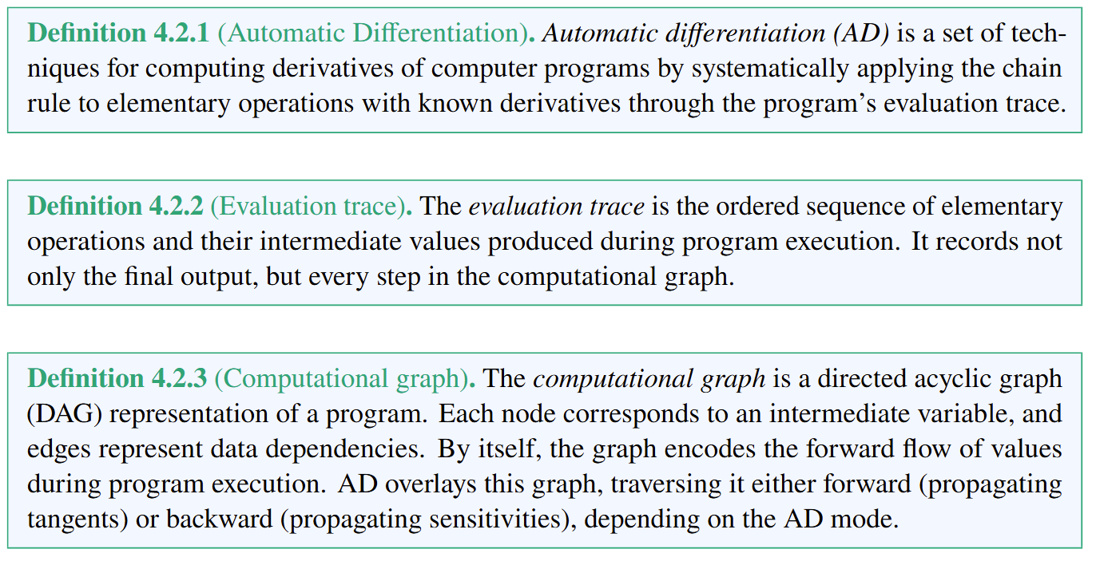
Automatic Differentiation (AD)

Slide 17
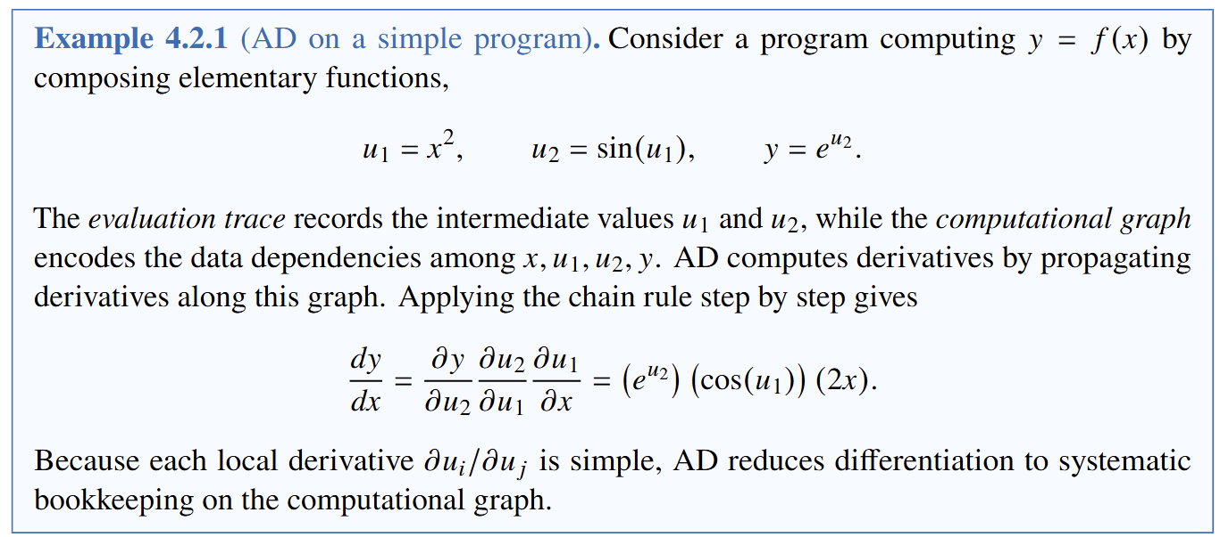
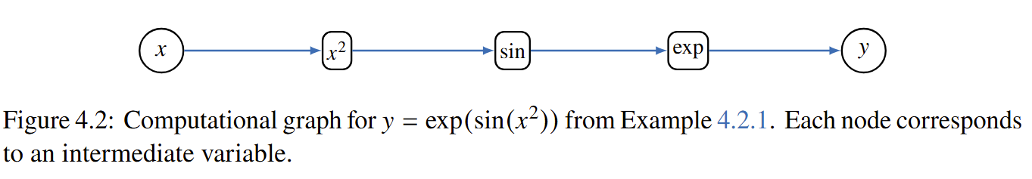
Simple AD Example

Slide 18
Simple AD Example

Slide 19
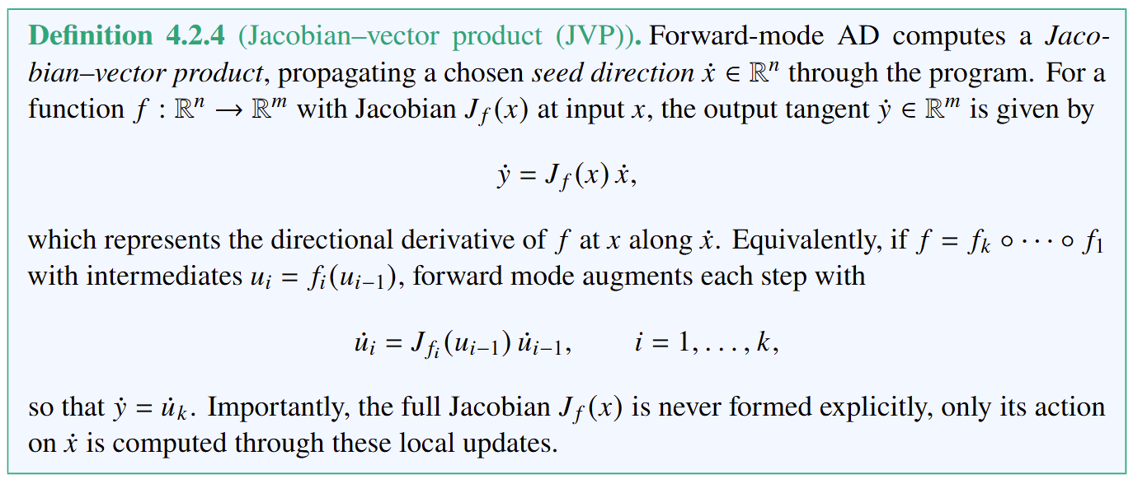
Forward-mode Automatic Differentiation (AD)

Slide 20
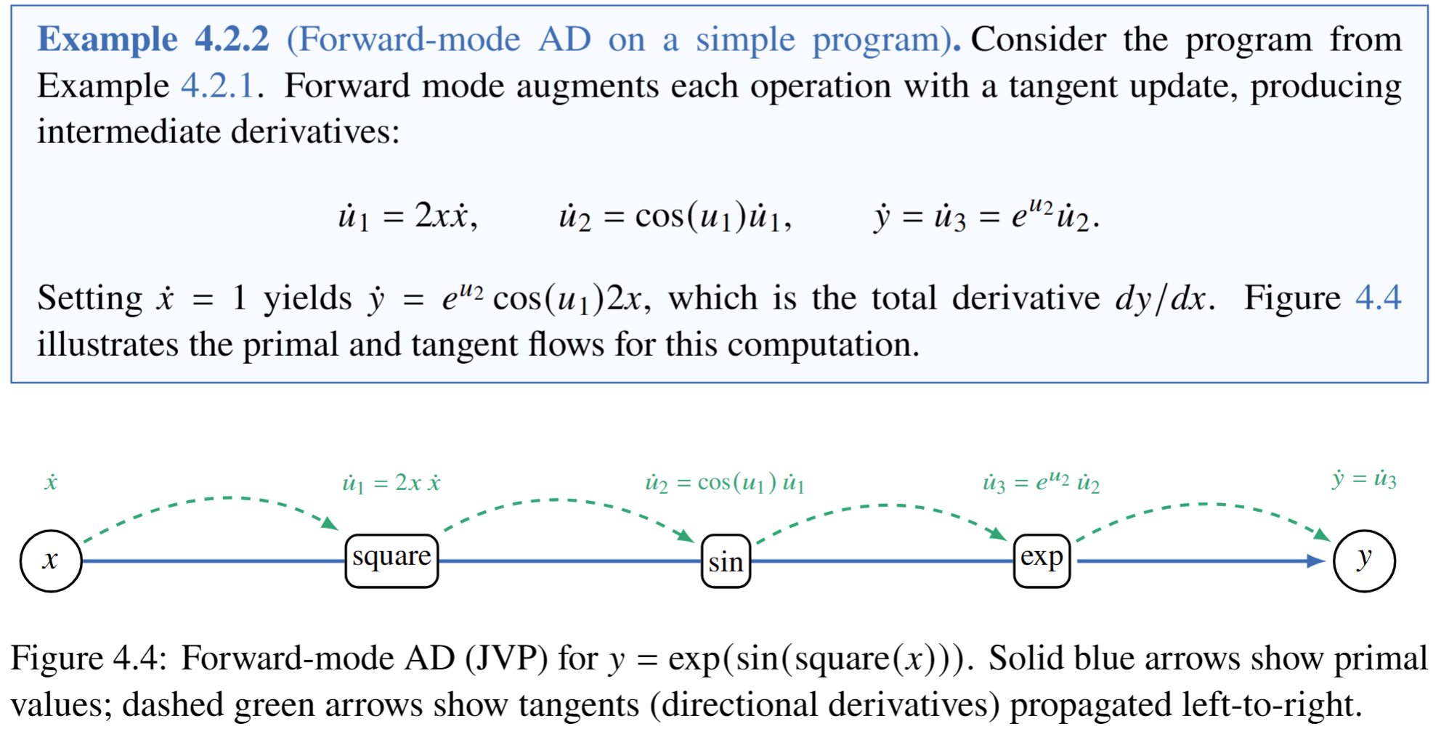
Forward-mode Automatic Differentiation (AD) Example

Slide 21
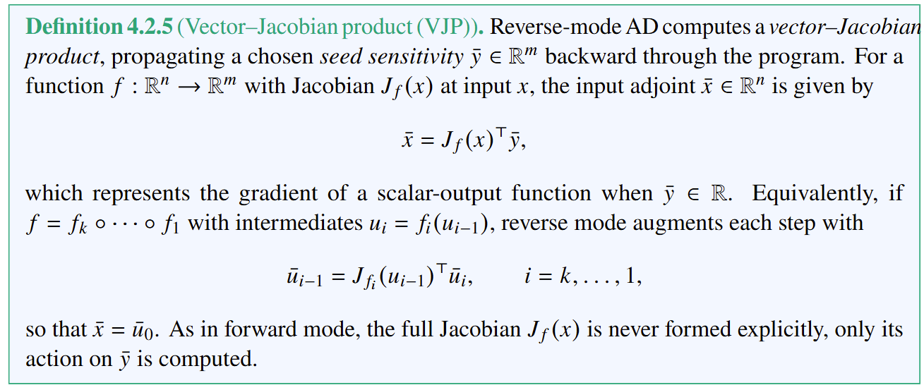
Reverse-mode Automatic Differentiation (AD)

Slide 22
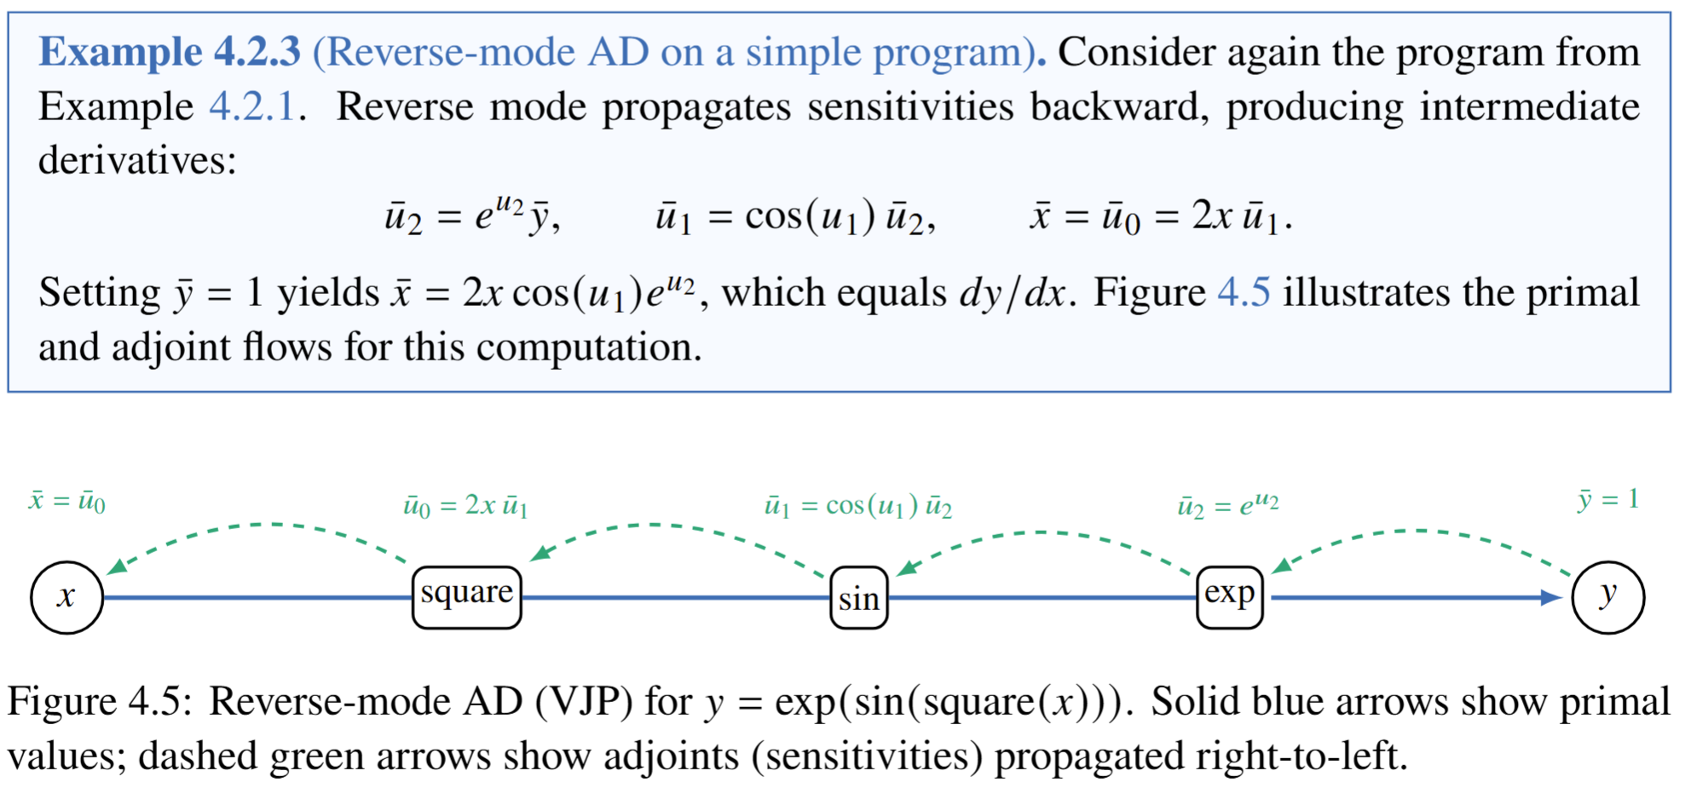
Reverse-mode Automatic Differentiation (AD) Example

Slide 23
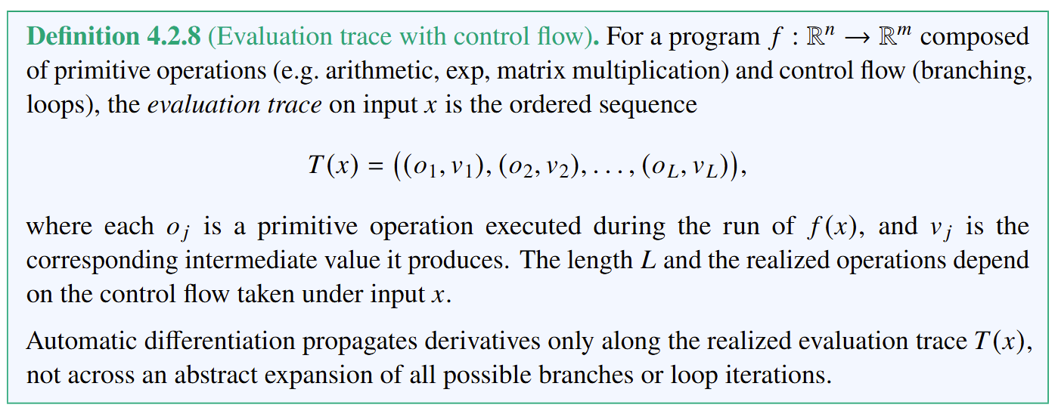
Evaluation Trace with Control Flow

Slide 24
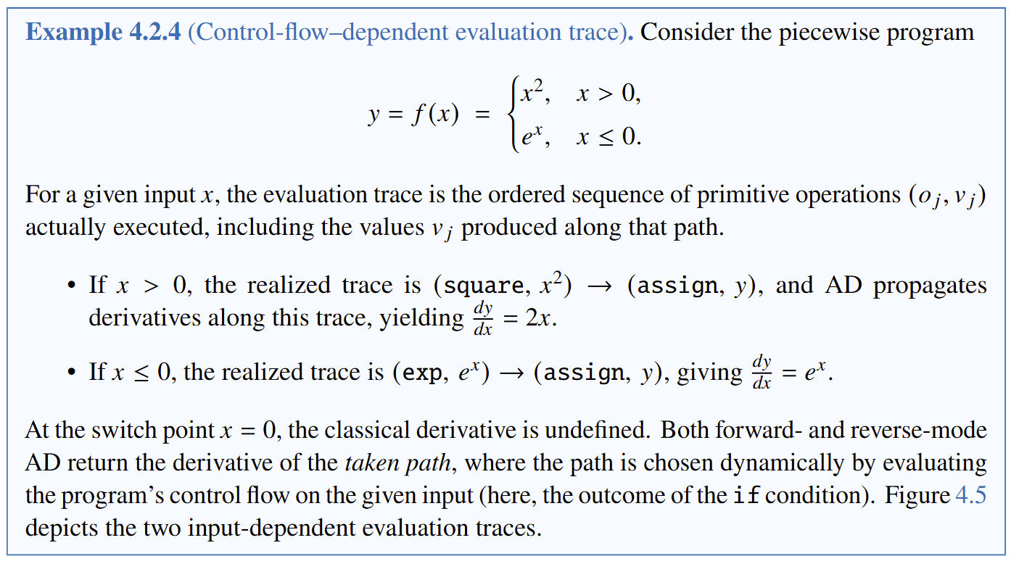
Example of Evaluation Trace with if/else Branches

Slide 25
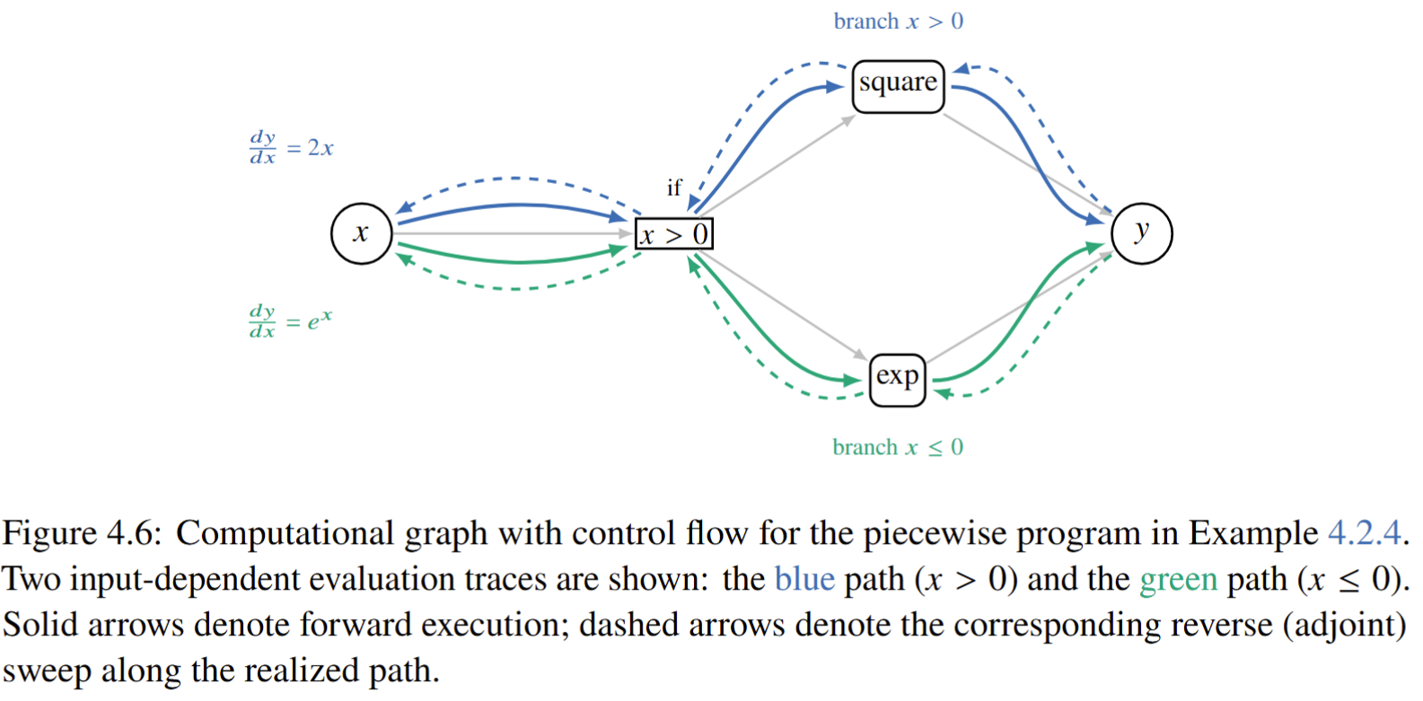
Evaluation Trace with Control Flow Example

Slide 26
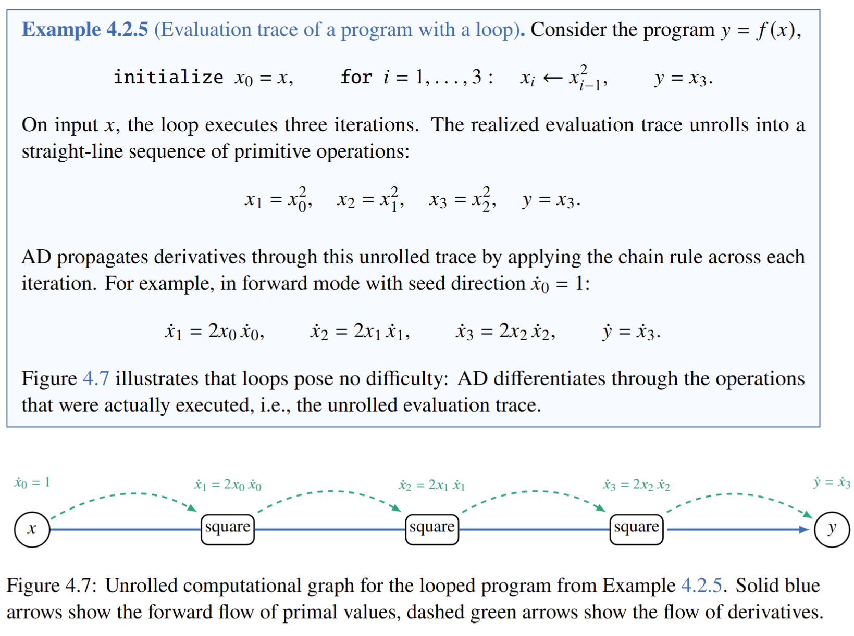
Example of Evaluation Trace with Loop

Slide 27
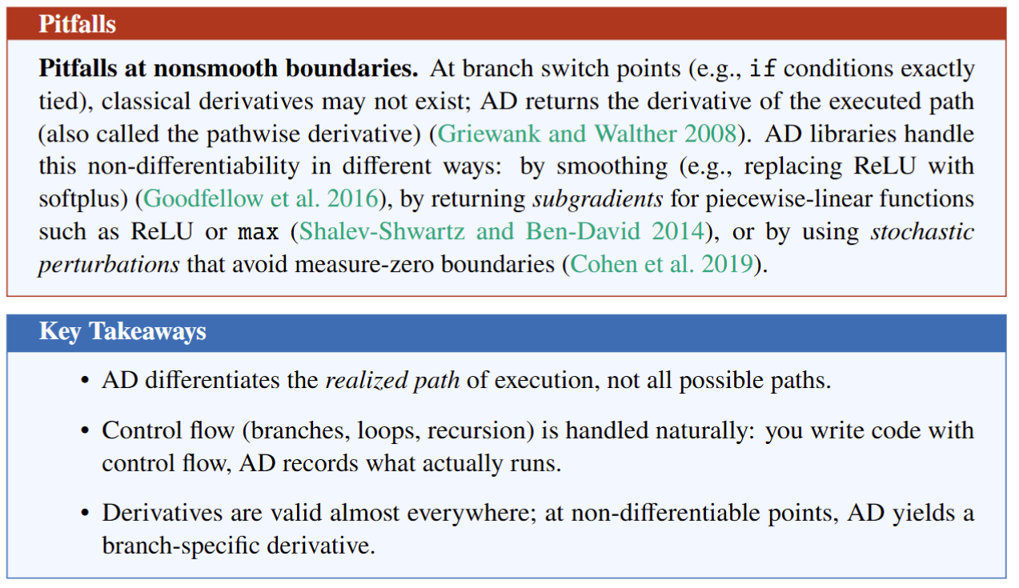
AD with Control Flow Pitfalls and Key Takeaways

Slide 28
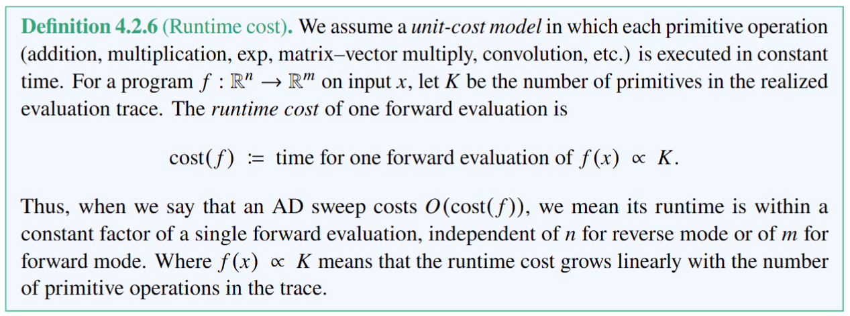
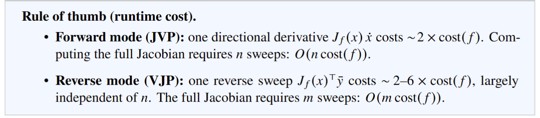
AD Runtime Cost

Slide 29
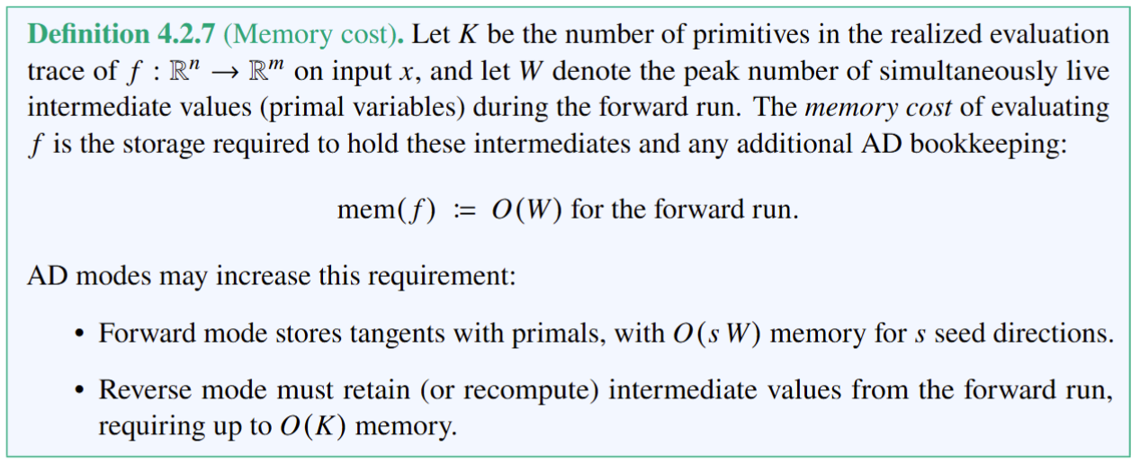
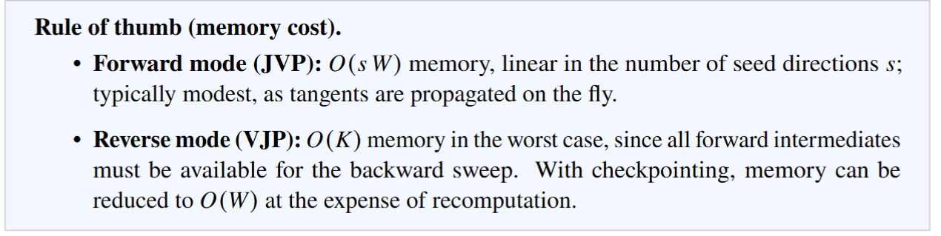
AD Memory Cost

Slide 30

Computing Higher Order Derivatives via AD

Slide 31














Differentiable Programming Languages and Libraries
AD-supported Languages
Domain-specific Languages and Libraries Utilizing AD
Machine Learning Libraries

Slide 32
References
Historical References
Wengert, R. E. (Aug. 1964). “A simple automatic derivative evaluation program”. In: Commun. ACM 7.8, pp. 463–464. issn: 0001-0782
Linnainmaa, S. (June 1976). “Taylor expansion of the accumulated rounding error”. In: BIT 16.2,pp. 146–160. issn: 0006-3835.
Speelpenning, B. (1980). “Compiling Fast Partial Derivatives of Functions Given by Algorithms”. PhD thesis. University of Illinois at Urbana–Champaign.
Rumelhart, D. E., G. E. Hinton, and R. J. Williams (1986). “Learning Representations by Back-propagating Errors”. In: Nature
Bischof, C. H., et al. (1992). “ADIFOR—Generating Derivative Codes from Fortran Programs”. In: Scientific Programming 1.1, pp. 11–29.
Pearlmutter, B. A. (1994). “Fast Exact Multiplication by the Hessian”. In: Neural Computation 6.1,pp. 147–160.
AD in Scientific Computing
Giles, M. B. and N. A. Pierce (2000). “An introduction to the adjoint approach to design”. In: Flow, Turbulence and Combustion 65, pp. 393–415.
Cao, Y., S. Li, L. Petzold, and R. Serban (2003). “Adjoint Sensitivity Analysis for Differential-Algebraic Equations: The Adjoint DAE System and Its Numerical Solution”. In: SIAM Journal on Scientific Computing 24.3, pp. 1076–1089.
Griewank, A. and A. Walther (2008). Evaluating Derivatives: Principles and Techniques of Algorithmic Differentiation. 2nd ed. Philadelphia, PA: SIAM.
Naumann, U. (2012). The Art of Differentiating Computer Programs: An Introduction to Algorithmic Differentiation. SIAM.
Innes, M., et al. (2019). A Differentiable Programming System to Bridge Machine Learning and Scientific Computing. arXiv: 1907.07587
AD in ML
Baydin, A. G., B. A. Pearlmutter, A. A. Radul, and J. M. Siskind (Jan. 2017). “Automatic differentiation in machine learning: a survey”. JMLR
Merriënboer, B. van, D. Moldovan, and A. Wiltschko (2018). “Automatic Differentiation in Machine Learning: Where We Are and Where We Should Be Going”. In: Advances in Neural Information Processing Systems (NeurIPS)
Blondel, M. and V. Roulet (2024). “The Elements of Differentiable Programming”. In: arXiv preprint arXiv:2403.14606.
Scardapane, S. (2024). Alice’s Adventures in a Differentiable Wonderland – Volume I, A Tour of the Land. arXiv: 2404.17625 [cs.LG].
Modern AD Tools
Bezanson, J., A. Edelman, S. Karpinski, and V. B. Shah (2017). “Julia: A Fresh Approach to Numerical Computing”. In: SIAM Review 59.1, pp. 65–98.
Bradbury, J., et al. (2018). JAX: composable transformations of Python + NumPy programs.
Hu, Y., et al. (2020). “DiffTaichi: Differentiable Programming for Physical Simulation”, ICLR.
Andersson, et al. (2019). “CasADi – A software framework for nonlinear optimization and optimal control”. Mathematical Programming Computation.

Slide 33
In-Class Exercises
Exercise 1: compute first order derivative dy/dx of a program from example 4.2.1. Compare forward and reverse mode AD (using pytorch or jax) with exact symbolic derivative and forward finite difference.
Exercise 2: compute second order derivative of a program from example 4.2.1. using AD.

Slide 34
Week 11: Project Presentations and Evaluation
Projects cover 50% of the course grade!
Project progress report 10% - week 8
Project final report 20% - week 10
Project presentation 20% - week 11
Project format.
Project technical report: 4-5 page pdf document including references and figures.
Project presentation: ppt or pdf slides, 15 min time slot per student in week 11.
Admissible topics.
Application of selected SciML methods to problems inspired by real-world applications
e.g., L2O for large scale optimization of energy systems.
Development of new methods tackling some of the open challenges in SciML
e.g., novel way of utilizing PINNs in differentiable control for PDEs.
New theory supporting selected SciML methodology
e.g., convergence analysis of feasibility restoration layers in L2O.

